Slide 1
INTERNSHIP PROJECT - SLINTEL
-By Mohit Bagaria (17EX20017)

Slide 2
Table Of Contents
About
Problem Statement
Project Objective
Use Case
Requirements
Introduction
Model Cycle

Slide 3
ABOUT - SLINTEL
A Sales Intelligence Platform, which helps to Identify Potential buyers in their Market & uncover top 5% prospects in their segment, using recent data
Use Slintel to identify the best selling opportunities that you can reach out to today
Get verified emails and direct dials for active, high intent buyers in your target markets
Understand buyer behaviour and pain points using buyer journeys and keyword insights
Streamline your pitch with technology adoption data
All in one place- company, contact, technology and intent data

Slide 4
Understanding the problem statement
01
Technologies Extraction From Linkedin Summaries
02
Data Available-
Technologies Names
Scraped Linkedin Profiles

Slide 5
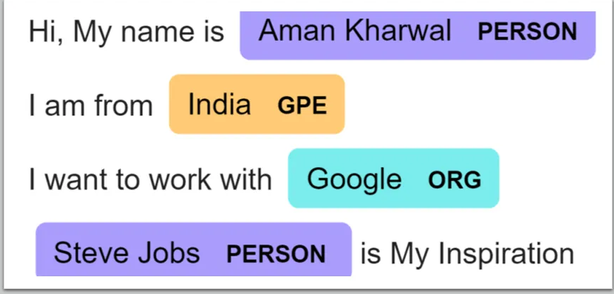
Project objective
To extract the Organisation names and the Technological keywords mentioned in their LinkedIn About or Summary section
This Problem Statement is Termed as NAMED ENTITY RECOGNITION (NER)

Slide 6
Use case
01
Slintel’s product has a Dashboard which provides direct leads of the People from the targeted companies
02
At this Moment, the people sometimes were not relevant
03
Task is to find people Using specific Technologies from a Specific Organization (Company or our target prospect)

Slide 7
Requirement
Tagged Dataset for Obtaining Accuracy Matrix
Solution: Manually Tagged Data with Context | String Match Run
Drawback:
Human Intervention
Takes high amount of time

Slide 8
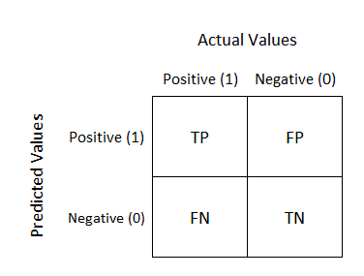
Introducing: Confusion Matrix
Accuracy Measure:
Decided to Use Confusion Matrix
True Positive (TP)
False Positive (FP)
False Negative (FN)
True Negative (TN)
Precision (true positives/predicted positives)=TP/TP+FP
Recall (true positives/all actual positives)=TP/TP+FN
F Score : Harmonic Mean of Precision and Recall => 2*(precision*recall)/(precision+recall)
Range : (0,1) Higher the better

Slide 9
Cycle diagram
04
Extract Summary
Model Training
LinkedIn About or Summary sections
Using SOTA BERT model for NER purposes specifically for our use case
01
03
Convert Data
Get feedback
Cleaning of Text and converting it to required format for model training
Cross checked with Business Analyst team, which confirmed AI performs better than conventional string match
02

Slide 10

Data Collection & Tagging
Step 0:
Slintel’s Data Engineers had scraped three kinds of data
LinkedIn Summaries (About section) of People
Technology Dictionary, ~ 24000 rows (Technological words for which we are sure are Technical or Organizational words, Ex: GitHub, MongoDB since these words have no other meaning other than a Technical one)
English Dictionary, ~6000 (Contextual words which might not be a technology , ex-’Python’ can referred as a snake and also as a Programming Language, same for ‘WorkSpace’)
Tag the dataset(Mark the Technical & Organizational words) Marking all the words using String Match and removing the contextual words which meant something else

Slide 11

Step 1: Cleaning
I removed the unnecessary symbols like & - / , : ; which might not be relevant. Apart from this common words like is the can be removed since it is basically a Noise in our data .Converting all text to lowercase
25%
Data Processing

Slide 12
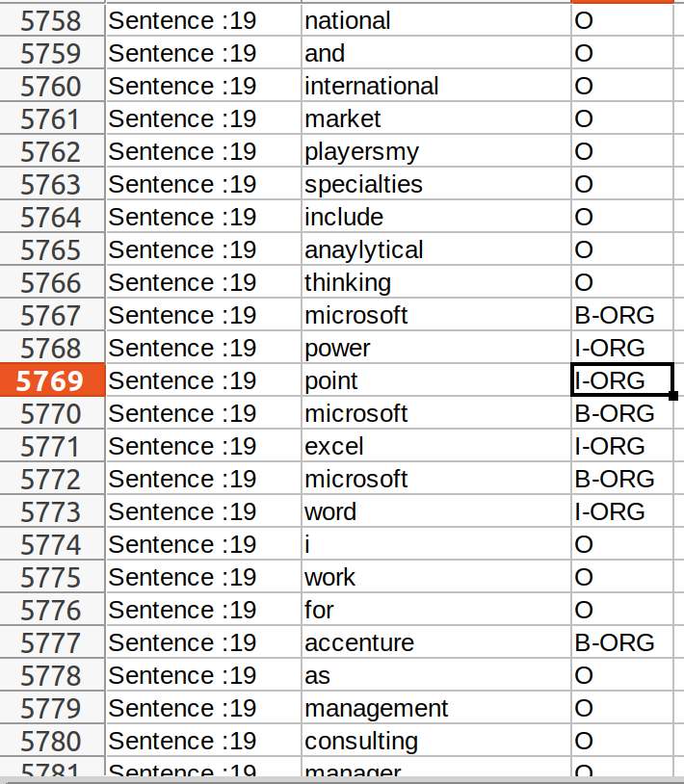
Step 2: Conversion to BIO format
All sentences are broken into words separated by space and tagged as B-org or I-org & O (The B- prefix before a tag indicates that the tag is the beginning of a chunk, & an I- prefix before a tag indicates that the tag is inside a chunk. An O tag indicates that a token belongs to no entity / chunk.)
25%
50%
Data Processing
BIO Formatting

Slide 13
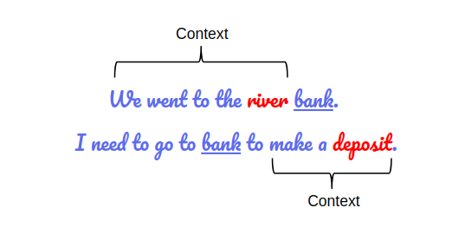
Step 3: Fine Tuning BERT
Fine-Tuned Bidirectional Encoder Representations from Transformers (BERT) model on our data to generate future predictions from text
An example where BERT model differentiates same word based on the Context of the sentence (Here: BANK)
25%
50%
75%
Data Processing
BIO Formatting
BERT Fine Tuning

Slide 14
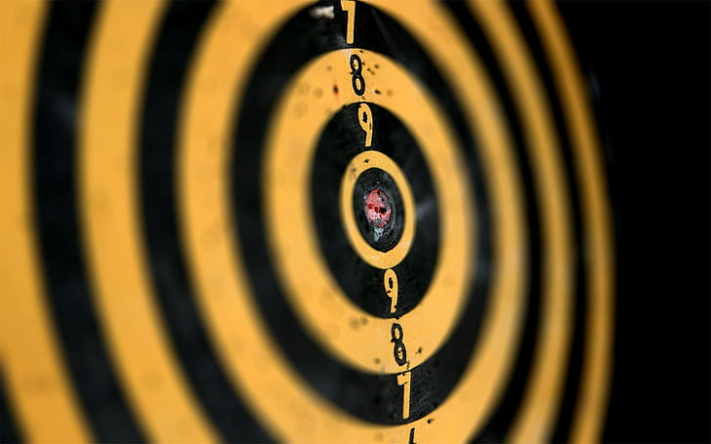
Step 4: Accuracy Analysis
Comparing accuracy for our use case on my trained model.
PRECISION -0.89
RECALL - 0.92
F1_SCORE- 0.904
25%
50%
75%
100%
Data Processing
BIO Formatting
BERT Fine Tuning
Comparison

Slide 15
Thank you!
-By Mohit Bagaria, 17EX200217
GEOLOGY & GEOPHYSICS
Data Science Intern at SLINTEL

